Slide 1
The Unix File System

Slide 2
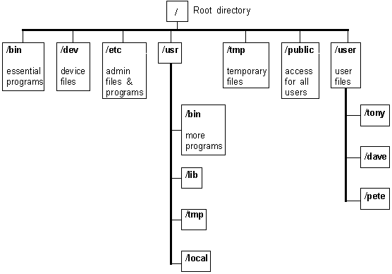

Slide 3
bin
Contains executable files for most of the commands
Commands can be either C programs or shell programs

Slide 4
lib
Contains all the library functions provided by linux for programmers
Programs written under Unix make use of these library functions in the lib directory

Slide 5
dev
Contains file that controls various input/output devices like terminals, printer, disk drives etc.
For each device there is a separate file
In Unix, each device is implemented as a file

Slide 6
usr
In this directory, there are several directories, each associated with a particular user.
These directories are created by system administrator when he creates accounts for different users
Within usr there is another bin directory which contains additional Unix command files

Slide 7
tmp
Contains the temporary files created by Unix or by the user
These files get automatically deleted when the system is shutdown and restarted

